Slide 1

MOVIE ANALYSIS
A Project By : Hemant Murkute

Slide 2
Task 5: IMDB Movies Analysis , Tech Stack Used: Microsoft Excel
Analysis done on the following points:-
Cleaning the data: This is one of the most important step to perform before moving forward with the analysis. Use your knowledge learned till now to do this. (Dropping columns, removing null values, etc.)
Your task: Clean the data
Movies with highest profit: Create a new column called profit which contains the difference of the two columns: gross and budget. Sort the column using the profit column as reference. Plot profit (y-axis) vs budget (x- axis) and observe the outliers using the appropriate chart type.
Your task: Find the movies with the highest profit?
Top 250: Create a new column IMDb_Top_250 and store the top 250 movies with the highest IMDb Rating (corresponding to the column: imdb_score). Also make sure that for all of these movies, the num_voted_users is greater than 25,000. Also add a Rank column containing the values 1 to 250 indicating the ranks of the corresponding films.
Extract all the movies in the IMDb_Top_250 column which are not in the English language and store them in a new column named Top_Foreign_Lang_Film. You can use your own imagination also!
Your task: Find IMDB Top 250

Slide 3
Analysis done on the following points:- (Continue)
D. Best Directors: Group the column using the director_name column.
Find out the top 10 directors for whom the mean of imdb_score is the highest and store them in a new column top10director. In case of a tie in IMDb score between two directors, sort them alphabetically.
Your task: Find the best directors
E. Popular Genres: Perform this step using the knowledge gained while performing previous
steps.
Your task: Find popular genres
F. Charts: Create three new columns namely, Meryl_Streep, Leo_Caprio, and Brad_Pitt which contain the movies in which the actors: 'Meryl Streep', 'Leonardo DiCaprio', and 'Brad Pitt' are the lead actors. Use only the actor_1_name column for extraction. Also, make sure that you use the names 'Meryl Streep', 'Leonardo DiCaprio', and 'Brad Pitt' for the said extraction.
Append the rows of all these columns and store them in a new column named Combined. Group the combined column using the actor_1_name column.
Find the mean of the num_critic_for_reviews and num_users_for_review and identify the actors which have the highest mean.
Observe the change in number of voted users over decades using a bar chart. Create a column
called decade which represents the decade to which every movie belongs to. For example, the title_year year 1923, 1925 should be stored as 1920s. Sort the column based on the
column decade, group it by decade and find the sum of users voted in each decade. Store this in a new data frame called df_by_decade.
Your task: Find the critic-favorite and audience-favorite actors

Slide 4
Cleaning the data
Your task: Clean the data
This is the most difficult and crucial step of any Data analysis project.
The process included in this step varies from question to question and Dataset to Dataset. To clean the dataset we will be:-
First dropping the columns which have no use for the analysis that we will be doing
Columns like ‘Color’, ‘director_facebook_likes’, ‘actor_3_facebook_likes, ‘actor_2_name’, ‘actor_1_facebook_likes’, ‘cast_total_facebook_likes, ‘actor_3_name’, ‘facenumber_in_posts’, ‘plot_keywords’, ‘movie_imdb_link’, ‘content_rating’ ,’actor_2_facebook_likes’, ‘aspect_ratio’, ‘movie_facebook_likes’ are the columns containing irrelevant data for the analysis tasks provided. So, these columns needs to be dropped.
After dropping the irrelevant columns now we need to remove the rows from the dataset having anyone of its column value as blank/NULL
Then we need to get rid off the duplicate values in the dataset which can be achieved by using the ‘Remove Duplicate Values/Cells’ available in the ‘Data’ tab
Google Drive link for
https://docs.google.com/spreadsheets/d/12yKWHQXSNivExUPeneER4FkrJ-upLV3N/edit?usp=sharing&ouid=101976269119944283329&rtpof=true&sd=true
the cleaned dataset

Slide 5
Movies with highest profit
Your task:
Find the movies with the highest profit?
To find the movies with the highest profit: -
First we need to subtract the budget value from the gross value to get the profit.
Then, by using the scatter plot option we will plot values of profit(y_axis) and
budget(x_axis)
Then with the help of graph we will be finding the outliers
Profit
2E+09
0
0
500
1000
1500
2000
2500
3000
3500
4000
4500
The outliers are:-
-12213298588
-4199788333
-2499804112
-2127109510
-1099560838
-2E+09
-4E+09
-6E+09
Profit
-8E+09
-1E+10
-1.2E+10
-1.4E+10

Slide 6
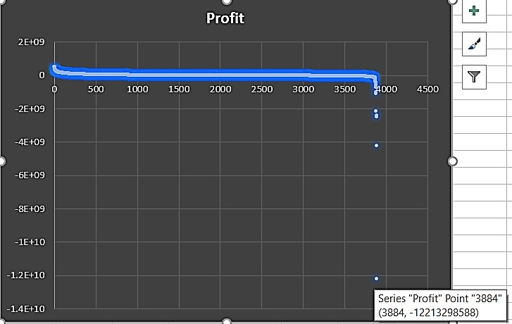
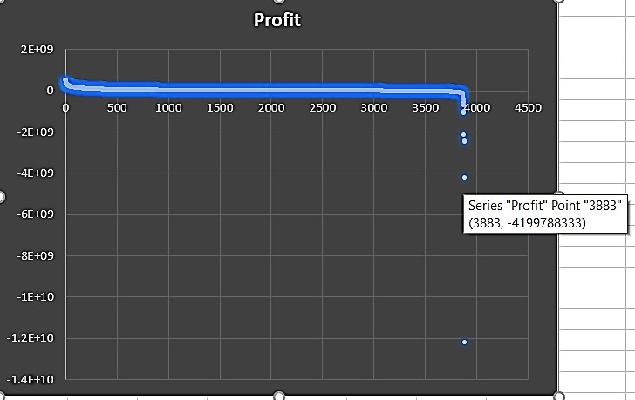
Movies with highest profit
Your task:
Find the movies with the highest profit?

Slide 7
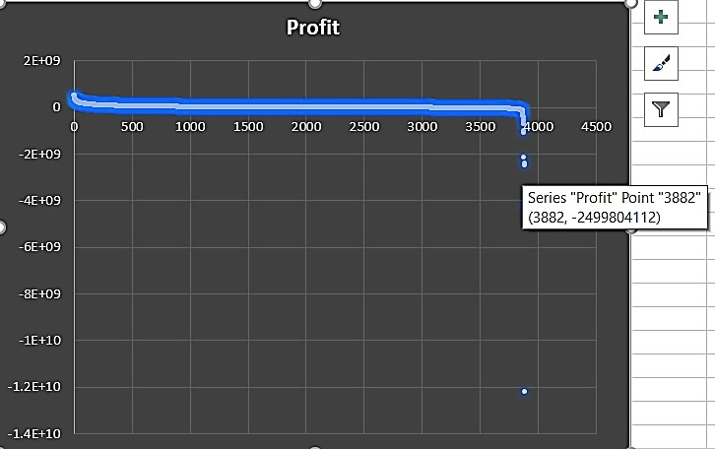
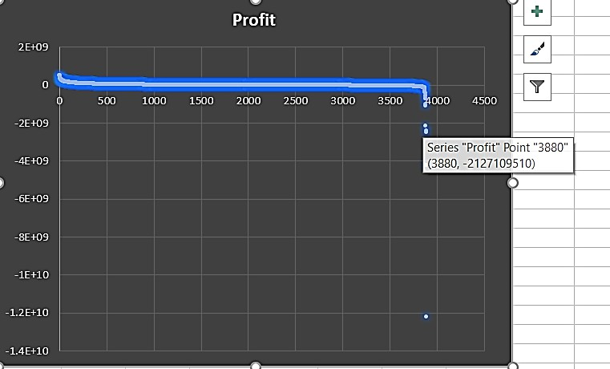
Movies with highest profit
Your task:
Find the movies with the highest profit?

Slide 8
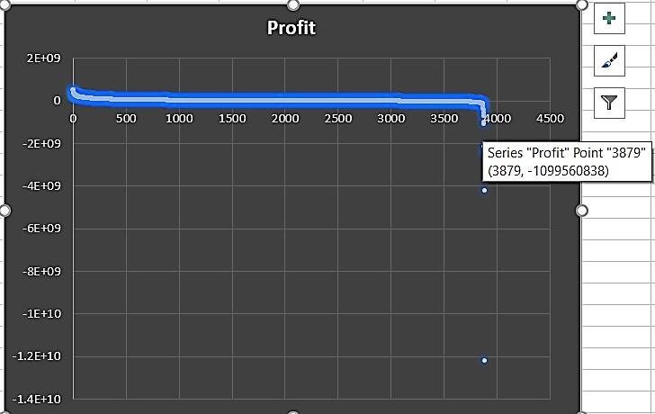
Movies with highest profit
Your task:
Find the movies with the highest profit?

Slide 9



Movies with highest profit
Your task:
Find the movies with the highest profit?
2E+09
0
-2E+09
-4E+09
budget 60000000
70000000
85000000
165000000
6000000
55000000
45000000
17000000
7000000
20000000
39000000
4000000
14000000
13000000
14000000
207000000
18000000
2000000
3000000
250000
300000
21500000
6800000
500000
1100000
6500000
6000000
10000000
8000000
6500000
10000000
60000000
19000000
18000000
25000000
35000000
20000000
50000000
65000000
57000000
50000000
70000000
225000000
Budget Profit
-6E+09
-8E+09
-1E+10
-1.2E+10
-1.4E+10
Google Drive link for
https://docs.google.com/spreadsheets/d/1vpSRosdHYGrP-6ruL2OMkfg_OTPQxm0M/edit?usp=sharing&ouid=101976269119944283329&rtpof=true&sd=true
the excel sheet

Slide 10
Movies with highest profit
Your task:
Find the movies with the highest profit?
Top 5 Movies with the Highest Profit are
director_name | num_critic _for_revie ws | gross | genres | actor_1_name | movie_title | num_voted _users | num_user _for_revie ws | language | country | content _rating | budget | title_year | imdb_sc ore | Profit
James Cameron | 723 | 760505847 | Action|Adventure| Fantasy|Sci-Fi | CCH Pounder | AvatarÂ | 886204 | 3054 | English | USA | PG-13 | 237000000 | 2009 | 7.9 | 523505847
Colin Trevorrow | 644 | 652177271 | Action|Adventure| Sci-Fi|Thriller | Bryce Dallas Howard | Jurassic WorldÂ | 418214 | 1290 | English | USA | PG-13 | 150000000 | 2015 | 7 | 502177271
James Cameron | 315 | 658672302 | Drama|Romance | Leonardo DiCaprio | TitanicÂ | 793059 | 2528 | English | USA | PG-13 | 200000000 | 1997 | 7.7 | 458672302
George Lucas | 282 | 460935665 | Action|Adventure| Fantasy|Sci-Fi | Harrison Ford | Star Wars: Episode IV - A New HopeÂ | 911097 | 1470 | English | USA | PG | 11000000 | 1977 | 8.7 | 449935665
Steven Spielberg | 215 | 434949459 | Family|Sci-Fi | Henry Thomas | E.T. the Extra-TerrestrialÂ | 281842 | 515 | English | USA | PG | 10500000 | 1982 | 7.9 | 424449459

Slide 11
Top 250
Your task:
Find IMDB Top 250
To find the IMDB Top 250 we will:-
First we will filter out those rows whose num_voted_users > 25000 using the sort
and filter option
Then we will arrange the dataset on the basis of imdb_score in descending order
Then we will select only the top 250 rows for the further analysis
Then we will create a new column rank using the RANK() function and using the
formula
=RANK(N2,$N$2:$N$251,0)+COUNTIFS($N$2:N2,N2)-1
Then we will filter out (unselect ‘English’) from the language column and we will
get the desired output
Google Drive link for
https://docs.google.com/spreadsheets/d/1uePEs7ky3d8tcFvrd8aBsZEM6riXLi_I/edit?usp=sharing&ouid=101976269119944283329&rtpof=true&sd=true
the excel sheet for
imdb_top_250
Google Drive link for
https://docs.google.com/spreadsheets/d/1OudYqu--IUZ3sKYyCLZ3yQrE3pk5xU3w/edit?usp=sharing&ouid=101976269119944283329&rtpof=true&sd=true
the excel sheet for
imdb_top_250_non_e
nglish

Slide 12
Top 250
Your task:
Find IMDB Top 250
Top 5 IMDB Movies(all language) are:-
director_name | num_cri tic_for_r eviews | gross | genres | actor_1_name | movie_title | num_voted_users | num_user _for_revie ws | language | country | content_ra ting | budget | title_year | imdb_score | Rank
Frank Darabont | 199 | 28341469 | Crime|Drama | Morgan Freeman | The Shawshank RedemptionÂ | 1689764 | 4144 | English | USA | R | 25000000 | 1994 | 9.3 | 1
Francis Ford Coppola | 208 | 134821952 | Crime|Drama | Al Pacino | The GodfatherÂ | 1155770 | 2238 | English | USA | R | 6000000 | 1972 | 9.2 | 2
Christopher Nolan | 645 | 533316061 | Action|Crime|Drama| Thriller | Christian Bale | The Dark KnightÂ | 1676169 | 4667 | English | USA | PG-13 | 185000000 | 2008 | 9 | 3
Francis Ford Coppola | 149 | 57300000 | Crime|Drama | Robert De Niro | The Godfather: Part IIÂ | 790926 | 650 | English | USA | R | 13000000 | 1974 | 9 | 4
Peter Jackson | 328 | 377019252 | Action|Adventure|Dra ma|Fantasy | Orlando Bloom | The Lord of the Rings: The Return of the KingÂ | 1215718 | 3189 | English | USA | PG-13 | 94000000 | 2003 | 8.9 | 5
Top 5 IMDB Movies(all languages(except English)) are:-
director_name | num_critic _for_review s | gross | genres | actor_1_name | movie_title | num_voted_ users | num_user_for_ reviews | language | country | content_ra ting | budget | title_ year | imdb_score | Rank
Sergio Leone | 181 | 6100000 | Western | Clint Eastwood | The Good, the Bad and the UglyÂ | 503509 | 780 | Italian | Italy | Approved | 1200000 | 1966 | 8.9 | 8
Fernando Meirelles | 214 | 7563397 | Crime|Drama | Alice Braga | City of GodÂ | 533200 | 749 | Portuguese | Brazil | R | 3300000 | 2002 | 8.7 | 19
Akira Kurosawa | 153 | 269061 | Action|Adventure| Drama | Takashi Shimura | Seven SamuraiÂ | 229012 | 596 | Japanese | Japan | Unrated | 2000000 | 1954 | 8.7 | 20
Hayao Miyazaki | 246 | 10049886 | Adventure|Animati on|Family|Fantasy | Bunta Sugawara | Spirited AwayÂ | 417971 | 902 | Japanese | Japan | PG | 19000000 | 2001 | 8.6 | 25
Florian Henckel von Donnersmarck | 215 | 11284657 | Drama|Thriller | Sebastian Koch | The Lives of OthersÂ | 259379 | 407 | German | Germany | R | 2000000 | 2006 | 8.5 | 45

Slide 13
Best Directors
Your task: Find the best directors
To find the best top 10 directors on the basis of mean of imdb_score we will:-
First select the imdb_score column of the cleaned dataset
Then we will click on pivot table
We will add director_name into the series section of the pivot table
Then we will add average imdb_score into the values section of the pivot table
Then we will first sort the data on the basis of average of imdb_score in
descending order and then on the basis of director name alphabetically
Result:
Top 10 director having the highest IMDB mean
Director Name | mean of Imdb Score
Charles Chaplin | 8.6
Tony Kaye | 8.6
Alfred Hitchcock | 8.5
Damien Chazelle | 8.5
Majid Majidi | 8.5
Ron Fricke | 8.5
Sergio Leone | 8.433333333
Christopher Nolan | 8.425
Asghar Farhadi | 8.4
Marius A. Markevicius | 8.4

Slide 14
Best Directors
Your task: Find the best directors
Google Drive link for
https://docs.google.com/spreadsheets/d/13gkhKm5xEYW9y9D-mbcvy_Ag3Efw55nN/edit?usp=sharing&ouid=101976269119944283329&rtpof=true&sd=true
the excel sheet for
Top_10_directors

Slide 15
Popular Genres
Your task:
Find popular genres
To find the Popular Genres we will:-
First select the genres column of the cleaned dataset
Then we will go for the pivot table option
Then we will Select the genres name as row labels
Then we will the values as the count of the number of genres and then sort it in descending order on the basis of count of the number of genres
Result:
Top 10 Popular genres are:-
Genre name | count
Drama | 153
Comedy|Drama|Romance | 151
Comedy|Drama | 147
Comedy | 145
Comedy|Romance | 135
Drama|Romance | 119
Crime|Drama|Thriller | 82
Action|Crime|Thriller | 55
Action|Crime|Drama|Thriller | 50
Action|Adventure|Sci-Fi | 46

Slide 16
Popular Genres
Your task:
Find popular genres
Google Drive link for
https://docs.google.com/spreadsheets/d/1WX5pEESR0QCTzisDQeIgeetkhIQrpbMd/edit?usp=sharing&ouid=101976269119944283329&rtpof=true&sd=true
the excel sheet for
Popular genres

Slide 17
Charts
Your task:
Find the critic-favorite and audience-favorite actors
To find the critic-favorite and audience-favorite actors we will:-
First three new columns namely, Meryl_Streep, Leo_Caprio, and Brad_Pitt which contain the movies in which the actors: 'Meryl Streep', 'Leonardo DiCaprio', and 'Brad Pitt' are the lead actors from the actor_1_name column
Then we will append the above 3 created columns into 1 column named
actor_1_name_combine
Then we will group the 3 columns of critic-favorite and audience-favorite actors
Then using the pivot table we will find the average, sum and count of critic- favorite and audience-favorite actors
Dataset for actor named Meryl_Streep
director_name | num_critic_f or_reviews | gross | genres | actor_1_name | movie_title | num_voted_users | num_user_for_reviews | language | country | content_rating | budget | title_year | imdb_score
Nancy Meyers | 187 | 112703470 | Comedy|Drama|Romance | Meryl Streep | It's ComplicatedÂ | 69860 | 214 | English | USA | R | 85000000 | 2009 | 6.6
Curtis Hanson | 42 | 46815748 | Action|Adventure|Crime|Thriller | Meryl Streep | The River WildÂ | 32544 | 69 | English | USA | PG-13 | 45000000 | 1994 | 6.3
Nora Ephron | 252 | 94125426 | Biography|Drama|Romance | Meryl Streep | Julie & JuliaÂ | 79264 | 277 | English | USA | PG-13 | 40000000 | 2009 | 7
David Frankel | 208 | 124732962 | Comedy|Drama|Romance | Meryl Streep | The Devil Wears PradaÂ | 286178 | 631 | English | USA | PG-13 | 35000000 | 2006 | 6.8
Robert Redford | 227 | 14998070 | Drama|Thriller|War | Meryl Streep | Lions for LambsÂ | 41170 | 298 | English | USA | R | 35000000 | 2007 | 6.2
Sydney Pollack | 66 | 87100000 | Biography|Drama|Romance | Meryl Streep | Out of AfricaÂ | 52339 | 200 | English | USA | PG | 31000000 | 1985 | 7.2
David Frankel | 234 | 63536011 | Comedy|Drama|Romance | Meryl Streep | Hope SpringsÂ | 34258 | 178 | English | USA | PG-13 | 30000000 | 2012 | 6.3
Carl Franklin | 64 | 23209440 | Drama | Meryl Streep | One True ThingÂ | 9283 | 112 | English | USA | R | 30000000 | 1998 | 7
Stephen Daldry | 174 | 41597830 | Drama|Romance | Meryl Streep | The HoursÂ | 102123 | 660 | English | USA | PG-13 | 25000000 | 2002 | 7.6
Phyllida Lloyd | 331 | 29959436 | Biography|Drama|History | Meryl Streep | The Iron LadyÂ | 82327 | 350 | English | UK | PG-13 | 13000000 | 2011 | 6.4
Robert Altman | 211 | 20338609 | Comedy|Drama|Music | Meryl Streep | A Prairie Home CompanionÂ | 19655 | 280 | English | USA | PG-13 | 10000000 | 2006 | 6.8

Slide 18
Charts
Your task:
Find the critic-favorite and audience-favorite actors
Dataset for actor named Leonardo_DiCaprio
director_name | num_critic_for_review s | gross | genres | actor_1_name | movie_title | num_voted_users | num_user_for_revie ws | langua ge | country | content_rating | budget | title_year | imdb_scor e
James Cameron | 315 | 658672302 | Drama|Romance | Leonardo DiCaprio | TitanicÂ | 793059 | 2528 | English | USA | PG-13 | 200000000 | 1997 | 7.7
Baz Luhrmann | 490 | 144812796 | Drama|Romance | Leonardo DiCaprio | The Great GatsbyÂ | 362912 | 753 | English | Australi a | PG-13 | 105000000 | 2013 | 7.3
Christopher Nolan | 642 | 292568851 | Action|Adventure|Sci-Fi|Thriller | Leonardo DiCaprio | InceptionÂ | 1468200 | 2803 | English | USA | PG-13 | 160000000 | 2010 | 8.8
Alejandro G. IÃ±Ã¡rritu | 556 | 183635922 | Adventure|Drama|Thriller|Western | Leonardo DiCaprio | The RevenantÂ | 406020 | 1188 | English | USA | R | 135000000 | 2015 | 8.1
Martin Scorsese | 267 | 102608827 | Biography|Drama | Leonardo DiCaprio | The AviatorÂ | 264318 | 799 | English | USA | PG-13 | 110000000 | 2004 | 7.5
Quentin Tarantino | 765 | 162804648 | Drama|Western | Leonardo DiCaprio | Django UnchainedÂ | 955174 | 1193 | English | USA | R | 100000000 | 2012 | 8.5
Edward Zwick | 166 | 57366262 | Adventure|Drama|Thriller | Leonardo DiCaprio | Blood DiamondÂ | 400292 | 657 | English | German y | R | 100000000 | 2006 | 8
Martin Scorsese | 606 | 116866727 | Biography|Comedy|Crime|Drama | Leonardo DiCaprio | The Wolf of Wall StreetÂ | 780588 | 1138 | English | USA | R | 100000000 | 2013 | 8.2
Martin Scorsese | 233 | 77679638 | Crime|Drama | Leonardo DiCaprio | Gangs of New YorkÂ | 314033 | 1166 | English | USA | R | 100000000 | 2002 | 7.5
Martin Scorsese | 352 | 132373442 | Crime|Drama|Thriller | Leonardo DiCaprio | The DepartedÂ | 873649 | 2054 | English | USA | R | 90000000 | 2006 | 8.5
Martin Scorsese | 490 | 127968405 | Mystery|Thriller | Leonardo DiCaprio | Shutter IslandÂ | 786092 | 964 | English | USA | R | 80000000 | 2010 | 8.1
Ridley Scott | 238 | 39380442 | Action|Drama|Thriller | Leonardo DiCaprio | Body of LiesÂ | 174248 | 263 | English | USA | R | 70000000 | 2008 | 7.1
Steven Spielberg | 194 | 164435221 | Biography|Crime|Drama | Leonardo DiCaprio | Catch Me If You CanÂ | 525801 | 667 | English | USA | PG-13 | 52000000 | 2002 | 8
Danny Boyle | 118 | 39778599 | Adventure|Drama|Thriller | Leonardo DiCaprio | The BeachÂ | 176169 | 548 | English | USA | R | 50000000 | 2000 | 6.6
Sam Mendes | 323 | 22877808 | Drama|Romance | Leonardo DiCaprio | Revolutionary RoadÂ | 152591 | 414 | English | USA | R | 35000000 | 2008 | 7.3
Randall Wallace | 83 | 56876365 | Action|Adventure | Leonardo DiCaprio | The Man in the Iron MaskÂ | 125219 | 244 | English | USA | PG-13 | 35000000 | 1998 | 6.4
Clint Eastwood | 392 | 37304950 | Biography|Crime|Drama | Leonardo DiCaprio | J. EdgarÂ | 102728 | 279 | English | USA | R | 35000000 | 2011 | 6.6
Sam Raimi | 63 | 18636537 | Action|Thriller|Western | Leonardo DiCaprio | The Quick and the DeadÂ | 69197 | 216 | English | Japan | R | 32000000 | 1995 | 6.4
Jerry Zaks | 45 | 12782508 | Drama | Leonardo DiCaprio | Marvin's RoomÂ | 20163 | 71 | English | USA | PG-13 | 23000000 | 1996 | 6.7
Baz Luhrmann | 106 | 46338728 | Drama|Romance | Leonardo DiCaprio | Romeo + JulietÂ | 167750 | 506 | English | USA | PG-13 | 14500000 | 1996 | 6.8
Baz Luhrmann | 490 | 144812796 | Drama|Romance | Leonardo DiCaprio | The Great GatsbyÂ | 362933 | 753 | English | Australi a | PG-13 | 105000000 | 2013 | 7.3

Slide 19
Charts
Your task:
Find the critic-favorite and audience-favorite actors
Dataset for actor named Brad_Pitt
director_name | num_critic_for _reviews | gross | genres | actor_1_n ame | movie_title | num_voted_u sers | num_user_for _reviews | language | country | content_rating | budget | title_year | imdb_scor e
David Fincher | 362 | 127490802 | Drama|Fantasy|Romance | Brad Pitt | The Curious Case of Benjamin ButtonÂ | 459346 | 822 | English | USA | PG-13 | 150000000 | 2008 | 7.8
Wolfgang Petersen | 220 | 133228348 | Adventure | Brad Pitt | TroyÂ | 381672 | 1694 | English | USA | R | 175000000 | 2004 | 7.2
Steven Soderbergh | 198 | 125531634 | Crime|Thriller | Brad Pitt | Ocean's TwelveÂ | 284852 | 627 | English | USA | PG-13 | 110000000 | 2004 | 6.4
Doug Liman | 233 | 186336103 | Action|Comedy|Crime|Romance|Thrille r | Brad Pitt | Mr. & Mrs. SmithÂ | 348861 | 798 | English | USA | PG-13 | 120000000 | 2005 | 6.5
Tony Scott | 142 | 26871 | Action|Crime|Thriller | Brad Pitt | Spy GameÂ | 121259 | 361 | English | German y | R | 92000000 | 2001 | 7
Steven Soderbergh | 186 | 183405771 | Crime|Thriller | Brad Pitt | Ocean's ElevenÂ | 402645 | 845 | English | USA | PG-13 | 85000000 | 2001 | 7.8
David Ayer | 406 | 85707116 | Action|Drama|War | Brad Pitt | FuryÂ | 303185 | 701 | English | USA | R | 68000000 | 2014 | 7.6
Jean-Jacques Annaud | 76 | 37901509 | Adventure|Biography|Drama|History|W ar | Brad Pitt | Seven Years in TibetÂ | 96385 | 119 | English | USA | PG-13 | 70000000 | 1997 | 7
David Fincher | 315 | 37023395 | Drama | Brad Pitt | Fight ClubÂ | 1347461 | 2968 | English | USA | R | 63000000 | 1999 | 8.8
Patrick Gilmore | 98 | 26288320 | Adventure|Animation|Comedy|Drama| Family|Fantasy|Romance | Brad Pitt | Sinbad: Legend of the Seven SeasÂ | 36144 | 91 | English | USA | PG | 60000000 | 2003 | 6.7
Neil Jordan | 120 | 105264608 | Drama|Fantasy|Horror | Brad Pitt | Interview with the Vampire: The Vampire ChroniclesÂ | 239752 | 406 | English | USA | R | 60000000 | 1994 | 7.6
Terrence Malick | 584 | 13303319 | Drama|Fantasy | Brad Pitt | The Tree of LifeÂ | 136367 | 975 | English | USA | PG-13 | 32000000 | 2011 | 6.7
Andrew Dominik | 273 | 3904982 | Biography|Crime|Drama|History|Wester n | Brad Pitt | The Assassination of Jesse James by the Coward Robert FordÂ | 136104 | 415 | English | USA | R | 30000000 | 2007 | 7.5
Alejandro G. IÃ±Ã¡rritu | 285 | 34300771 | Drama | Brad Pitt | BabelÂ | 243799 | 908 | English | France | R | 25000000 | 2006 | 7.5
Angelina Jolie Pitt | 131 | 531009 | Drama|Romance | Brad Pitt | By the SeaÂ | 7976 | 61 | English | USA | R | 10000000 | 2015 | 5.3
Andrew Dominik | 414 | 14938570 | Crime|Thriller | Brad Pitt | Killing Them SoftlyÂ | 111625 | 369 | English | USA | R | 15000000 | 2012 | 6.2
Tony Scott | 122 | 12281500 | Action|Crime|Drama|Romance|Thriller | Brad Pitt | True RomanceÂ | 163492 | 460 | English | USA | R | 13000000 | 1993 | 8

Slide 20







Charts
Your task:
Find the critic-favorite and audience-favorite actors
Row Labels | Average of num_user_for_reviews | Sum of num_user_for_reviews | Count of num_user_for_reviews2
Leonardo DiCaprio | 914.4761905 | 19204 | 21
Brad Pitt | 742.3529412 | 12620 | 17
Meryl Streep | 297.1818182 | 3269 | 11
Grand Total | 716.1836735 | 35093 | 49
25000
20000
19204
15000
Average of num_user_for_reviews Sum of num_user_for_reviews Count of num_user_for_reviews2
12620
10000
5000
3269
914.4761905
21
742.3529412
17
297.1818182
11
0
Leonardo DiCaprio
Brad Pitt
Meryl Streep

Slide 21







Charts
Your task:
Find the critic-favorite and audience-favorite actors
Row Labels | Average of num_critic_for_reviews | Sum of num_critic_for_reviews | Count of num_critic_for_reviews2
Leonardo DiCaprio | 330.1904762 | 6934 | 21
Brad Pitt | 245 | 4165 | 17
Meryl Streep | 181.4545455 | 1996 | 11
Grand Total | 267.244898 | 13095 | 49
8000
7000
6000
5000
4000
3000
2000
6934
4165
Average of num_critic_for_reviews Sum of num_critic_for_reviews Count of num_critic_for_reviews2
1996
1000
0
330.1904762
245
181.4545455
21 17
11
Leonardo DiCaprio Brad Pitt Meryl Streep
From the above two graphs we can infer that ‘Leonardo DiCaprio’ was both critic- favorite and audience-favorite actor

Slide 22

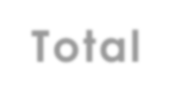
Charts
Change in number of voted users over decades using a bar chart
Total
2015
2012
2009
2006
2003
2000
1997
1994
1991
1988
1985
1982
1979
1976
1973
1970
1967
1964
1961
1957
1952 ₃9₁4₆5₇6
1947
1939
1935
1927 111841
3480550
12078443
18829510
20122057
₂2₂2₇8₄9₅1₉7₂7₂9
18572837
20492085
181₈5₅0₁7₃2₁6₁₃
20800046
14757710
17063110
19281850
12803958
151₁8₅8₇5₇5₂1₄₃₃
₉₆₁1₉0₀1₁5₆9594
13838951
5731028
75429₈8₃2₄₃₄₉₈
₃₅₀₈4₃1₅0₁8353
3051₃2₈0₃5₂₇₀₁
₂₃₃2₆8₆3₅9₈139
₁2₉0₄0₄7₂9₀8₅3
1540430₂₇₅₇₅₅₆
1₁7₇1₃6₉1₃6₀3₃
13₁8₇6₁4₉8₅6₅₃
₇₆₅1₀2₁4₄0599
Total
₄₁₅₀₈1₇365568
₁₂1₆4₉7₀4735
⁶⁶⁶1⁴1⁵7²2562
₄1₆0₇8₈2₁31
21₄6₅4₂2₆1₆₀
⁷⁵²5⁸0⁰3509
2₄9₉7₃8₆3₈9₅
1₃40₉2₄8₁0₇
⁷¹4⁹2¹2⁹432
1₄7₉5₄1₄9₄6
₁₁3₁2₇9₁902
³1²9⁵2⁸36
⁴1⁶6⁶1⁶6³81
₁₃5₃0₃7₄2₈15
₁1₃4₂3₆0₉86
₄7₅9₄2₆1
0
5000000
10000000
15000000
20000000
25000000

Slide 23


Charts
Change in number of voted users over decades using a bar chart
Decade | total num_of_votes_in_decade
1921-1930 | 116387
1931-1940 | 966520
1941-1950 | 72324
1951-1960 | 1097601
1961-1970 | 2607791
1971-1980 | 10196874
1981-1990 | 22100624
1991-2000 | 78706936
2001-2010 | 178592461
2011-2020 | 100148261
Total | 394605779
total num_of_votes_in_decade
2011-2020 |  |  |  |  | 100148261
2001-2010 |  |  |  |  |  |  |  |  | 178592461
1991-2000 |  |  |  | 78706936
1981-1990 | 22100624
1971-1980 | 10196874
1961-1970 | 2607791
1951-1960 | 1097601
1941-1950 | 72324
1931-1940 | 966520
1921-1930 | 116387
DECADE
0
20000000
40000000
60000000
80000000 100000000 120000000
TOTAL NUMBER OF VOTES IN EACH DEACDE
140000000
160000000
180000000
200000000
total num_of_votes_in_decade

Slide 24
Charts
Change in number of voted users over decades using a bar chart
Google Drive link for
https://docs.google.com/spreadsheets/d/1Y0lXz6PVosvcraRrC9DzZAsQExq1ppy4/edit?usp=sharing&ouid=101976269119944283329&rtpof=true&sd=true
the excel sheet for
highest mean of
voted users
Google Drive link for
https://docs.google.com/spreadsheets/d/16Rr20uvuQ0_TA9hyHTGKA9fHVoohK53l/edit?usp=sharing&ouid=101976269119944283329&rtpof=true&sd=true
the excel sheet for
number of voted
users over decades

Slide 25
Google Drive link for
https://drive.google.com/drive/folders/1nMJVW9og48RoKweDXOP6vEE_oYAeI2OZ?usp=sharing
all excel sheets

